Slide 1

CEIR Stolen / Recovery Feature -Training Manual

Slide 2

Stolen/Recovery
Feature
Stakeholder
State Diagram
UI Walk Thru
View All Stolen / Recovered Devices
View A Stolen/Recovered Device
Mark Device as Stolen for individual/Company
Mark Device as Recovered for Individual/Company
Withdraw Stolen/Recovery Request
Edit Stolen/Recovery Request
Approve Stolen/Recovery Request
Reject Stolen/Recovery Request

Slide 3


Feature Overview
Stolen/Recovery Feature allows Lawful agency to mark SIM based devices as stolen on CEIR system when reported stolen by end user/stakeholders.
Once the devices are recovered, the same is marked as recovered on CEIR system
Typical flow is as follows:
Stolen
End user / Stakeholder report device as stolen to lawful agency
Lawful agency check the authenticity of request (device ownership and user Identification)
Lawful Agency mark device as stolen using CEIR portal
Recovery
Lawful Agency recover the device
Lawful Agency mark device as recovered on the CEIR portal
Lawful agency handover the device to end user/company
Company User
Individual User
CEIR System

Slide 4
Feature Impact / Use Cases
Importance of this feature for the CEIR System
Customer would welcome this feedback, hence will bring goodwill to the whole CEIR program
Basis of this feature, local black list is created. Grey list would be created from this local black list
Stolen DB becomes one of the policy DB on which rule are applied. For ex, if the importer register a consignment, end user check IMEI, distributor upload stock, and the device is found in the stolen DB, then the request is rejected.

Slide 5
Stakeholder Overview
S.No. | User | Key Feature
1 | LawFul Agency | Mark Device as stolen/Recovered
2 | CEIR Authority | Approve/Reject stolen/recovery request
Both Cambodian and Foreigner can raise the request for stolen and recovered devices

Slide 6
State Transition – Overview - Stolen
LawFul Agency
System
CEIR Admin
Approved
Stolen Request State under various Stakeholder
NEW
PROCESSING
Pending for CEIR Approval
Mark as
Stolen
System
Process
System
Process
Approve
System
Process
Edit
Reject
Rejected by System
Edit by Lawful Agency
Rejected by
CEIR Admin
Device State under various Stakeholder
INIT
Pending
Stolen

Slide 7
State Transition – Overview - Recovery
LawFul Agency
System
CEIR Admin
Approved
Recovery Request State under various Stakeholder
NEW
PROCESSING
Pending for CEIR Approval
Mark as
Recovered
System
Process
System
Process
Approve
System
Process
Edit
Reject
Rejected by System
Edit by Lawful Agency
Rejected by
CEIR Admin
Device State under various Stakeholder
STOLEN
Pending
Active

Slide 8
State Transition - Overview

Slide 9
UI – Overview - Feature
S.No. | Feature | Stakeholder
1 | View all stolen/recovered devices request | Lawful Agency, CEIR Admin
2 | View a stolen/recovery request | Lawful Agency, CEIR Admin
3 | Approve Stolen/Recovery Request | CEIR Admin
4 | Reject Stolen/Recovery Request | CEIR Admin, System
5 | Edit | Lawful Agency
6 | Delete (Withdraw) | Lawful Agency, CEIR Admin
7 | View | Lawful Agency, CEIR Admin
8 | History | Lawful Agency, CEIR Admin

Slide 10
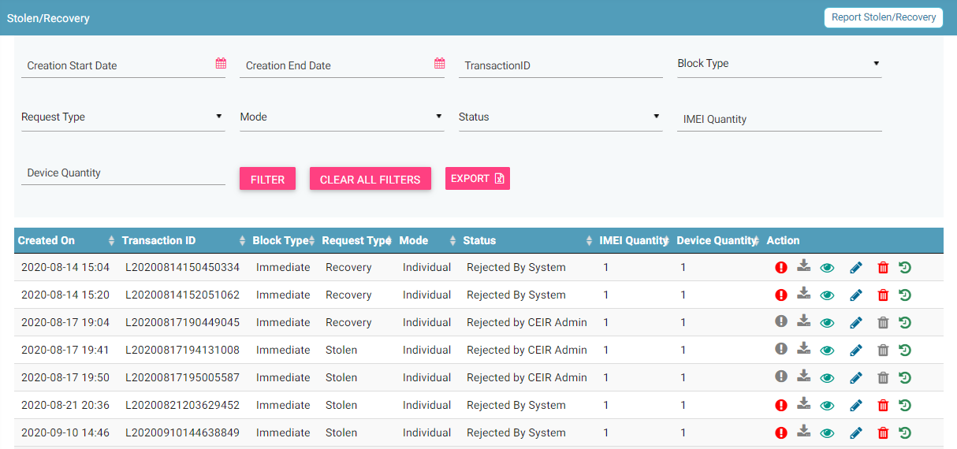
View All Stolen/Recovery Request
Report Stolen/ Recovery
Filters
Export
Action like View, Delete
View All Request

Slide 11
Action List
Action are enabled / disabled based on the state of the request.

Slide 12
Actions Enabled/ Disabled for Lawful Agency

Slide 13
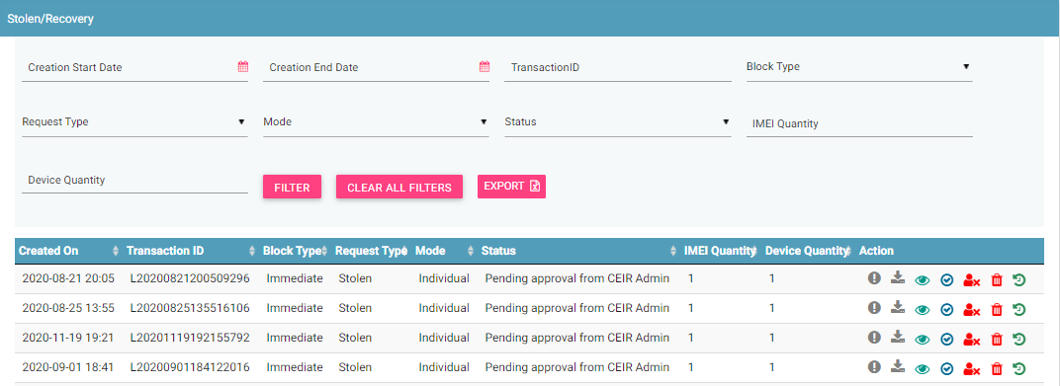
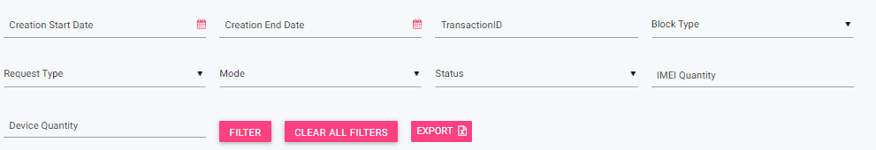
CEIR Admin Portal
By default, request with status “Pending approval from CEIR Admin” will be displayed in the CEIR Admin queue.
In case CEIR Admin wishes to view stolen/recovery request in any other state, they can use the filter options to display the same.

Slide 14
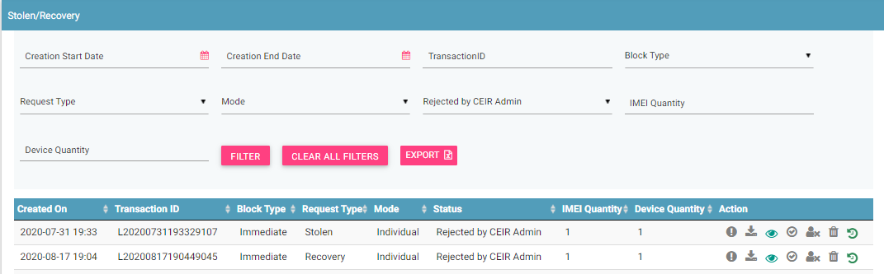
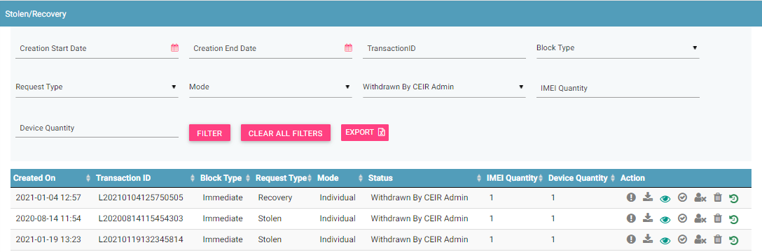
CEIR Admin Portal (contd.)
For request with status as PENDING APPROVAL FROM CEIR ADMIN, actions like View, Approve, Reject and Withdraw all will be enabled for CEIR Admin.
For request with status as REJECTED BY CEIR ADMIN , actions like View, Approve and Withdraw will be enabled for CEIR Admin.
For request with status as WITHDRAWN BY CEIR ADMIN, only View option will be enabled for CEIR Admin.
All other states will have only View option enabled for CEIR Admin.

Slide 15
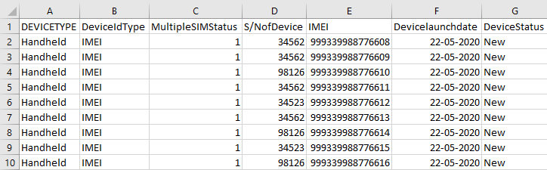
Stolen/ Recovery Flow
Lawful agency mark a device as stolen / recovered.
In order to mark device as stolen , a lawful agency needs to furnish the following details:
→ Personal information including name, ID and address
→ Device Information including mobile numbr, operator, device IMEI (Optional),
Place of Device Stolen
FIR copy and date of stolen
A unique Transaction ID is generated for each new request which is registered. This transaction id can be used in future for raising grievance (if any) regarding the request. The transaction ID will be used for tracking the reqeust at any state.
System processing is being done at the backend. Status = PROCESSING
In case the request is rejected by system. Status = REJECTED BY SYSTEM
System rejects the request in case there is some issue with the format of the file uploaded or any policy violation is done. The format of the file is available for download on the view screen.

Slide 16
Stolen / Recovery Flow ( contd..)
After successful internal processing, the request is sent to the CEIR Admin queue for Approval/ Rejection. Status = PENDING APPROVAL FROM CEIR ADMIN.
CEIR Admin rejects the request. Status = REJECTED BY CEIR ADMIN. Email is sent to Lawful Agency. Notifications is also displayed on the Lawful Agency dashboard.
CEIR Admin can also withdraw request. Status = WITHDRAWN BY CEIR ADMIN. This can be done in scenarios like Lawful has wrongly marked as device stolen and some other end user has rightly claimed the device.
CEIR Authority approves the request. Status = APPROVED. Email is sent to Lawful Agency. Notifications are also displayed on the Lawful Agency dashboard.
Lawful Agency can also withdraw request when it is in either NEW/ REJECTED BY SYSTEM state. Status = WITHDRAWN BY LAWFUL AGENCY

Slide 17
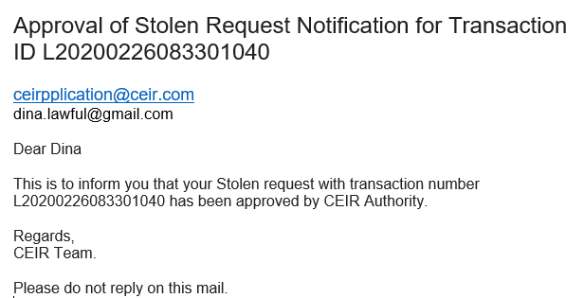
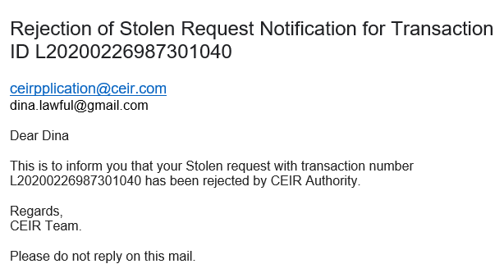
Email samples
Approved by CEIR
Rejected by CEIR
Email contents can be configured from the System Admin portal. This will be explained in detail in the system configuration training.

Slide 18
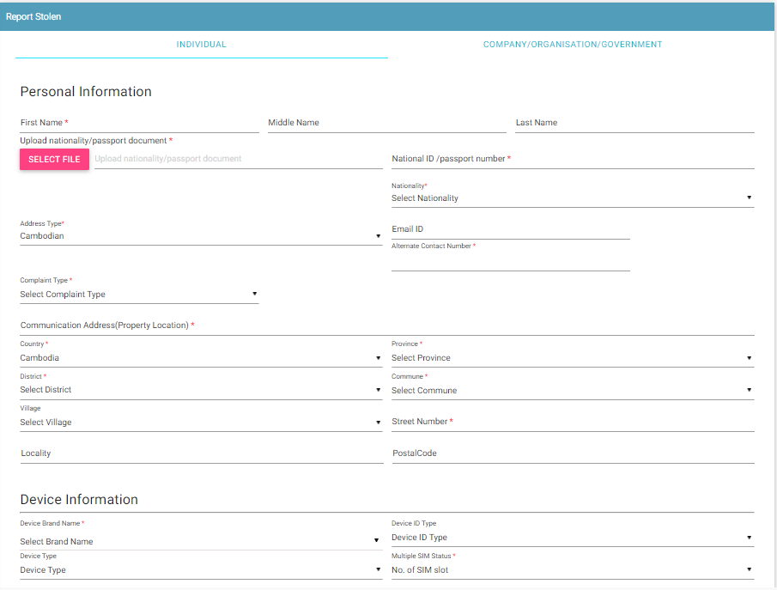
Mark Device as Stolen – Individual
Some Rules to Follow
Lawful Agency will ensure the device ownership and user ID to validate that request is coming from correct source.

Slide 19
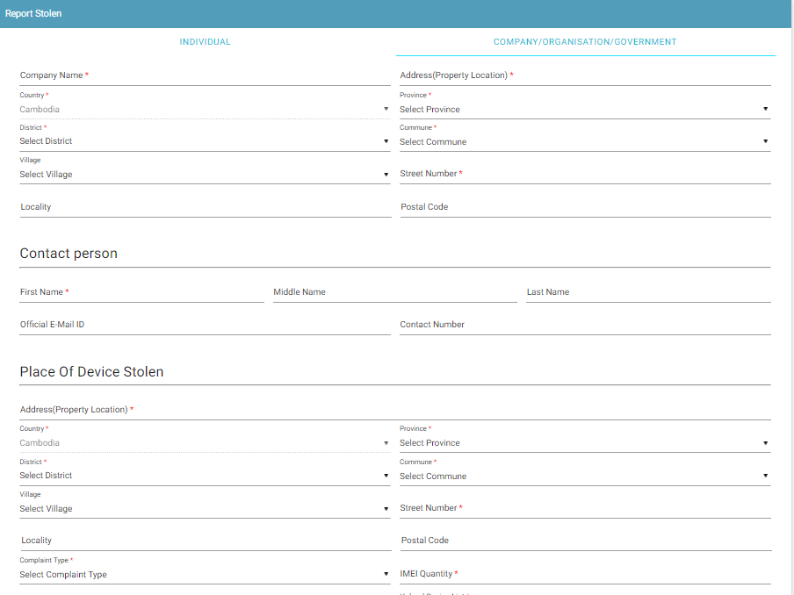
Mark Device as Stolen – Company
Some Rules to Follow
Lawful Agency will ensure the device ownership and user ID to validate that request is coming from correct source

Slide 20
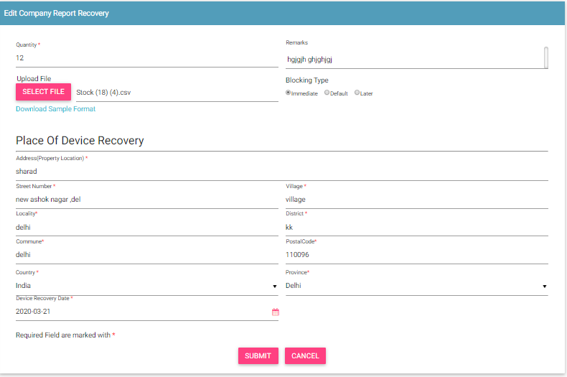
Edit Stolen / Recovery Request
Only allowed in rejected states
Rejected By System
Rejected By CEIR Admin
Edit By Lawful Agency
NEW
Request moved back to NEW state

Slide 21
Special Case – Stolen Device based on Mobile Number
User may not know the IMEI of the device. So, may give his mobile number.
The system look for operator CDR for this number for last 7 days.
If a single unique IMEI is found against this Mobile number, then that IMEI is blocked or else the request will be rejected by system

Slide 22
Special Case – Priority Blocking
User can define time when the device should be marked in black list
There are 3 monitoring period possible
Monitoring Period | Description
Immediate | The device will be blocked immediately.
Default | The device will be blocked as per period defined in the policy definition
Later | The device will be blocked as per date provided by user

Slide 23
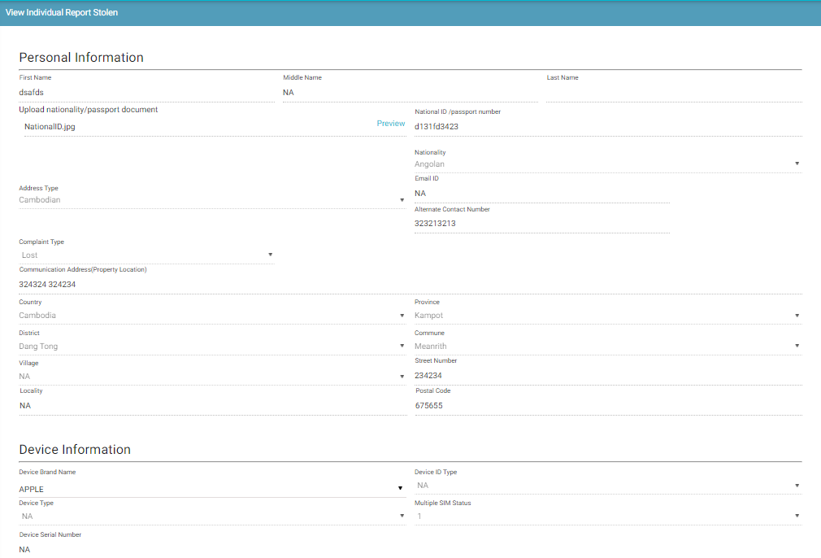
View Stolen / Recovery Request
Who all can view the stolen / recovery request?
Lawful Agency
CEIR Admin
This screen is not editable. This is just to view the details filled in by the Lawful Agency.

Slide 24
System Processing
All NEW requests will be processed in FIFO order by the system
Once the processing starts, the status is changed to PROCESSING to indicate that Work is in progress
Once the processing is complete, the status is changed to either REJECTED_BY_SYSTEM or SUCCESS (PENDING_APPROVAL_FROM_CEIR_ADMIN)
Post processing an e-mail notification is sent to Lawful Agency in case of REJECTED_BY_SYSTEM and in case of SUCCESS email is sent to both Lawful Agency and CEIR Admin.

Slide 25
System Processing – Stolen Case
If all the policy has passed for stolen request, then the IMEI is added in the grey list
If all the policy has passed for recovery request, then the IMEI is removed from the grey/black list as applicable

Slide 26
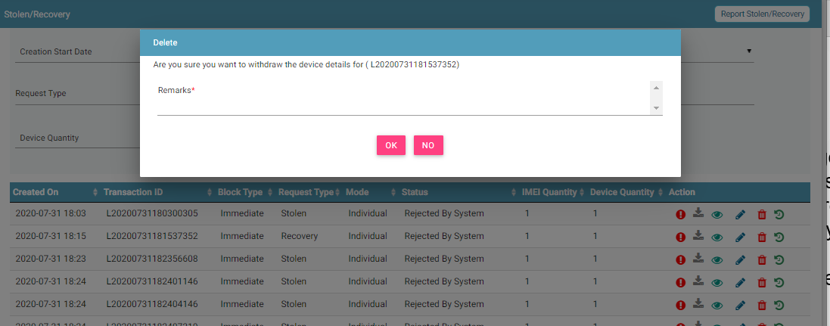
Stolen/ Recovery Request Withdrawn By Lawful Agency
Lawful Agency can withdraw stolen and recovery request in two states only
New
Rejected by System

Slide 27
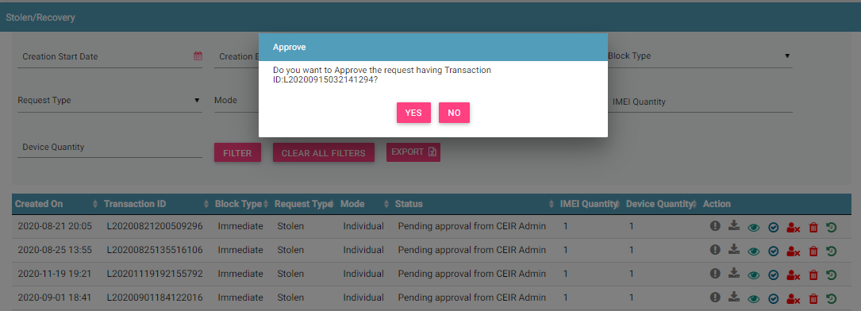
Request Approved by CEIR Admin
Request after successful processing are sent to the CEIR Admin queue for Approval / Rejection.
On Rejection, request are sent back to the Lawful Agency queue.

Slide 28
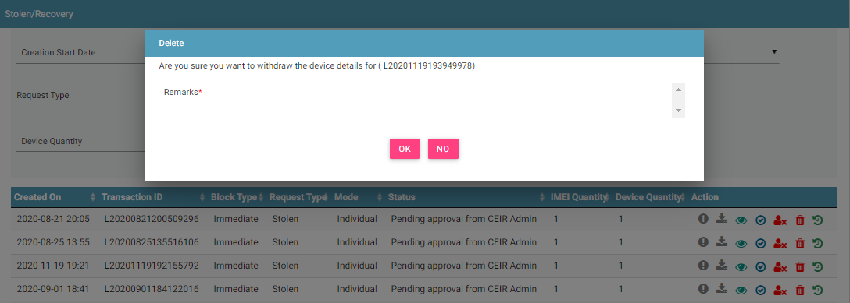
Request Rejected by CEIR Admin
CEIR Admin has the authority to reject any request. Remarks have to be updated for the same.

Slide 29
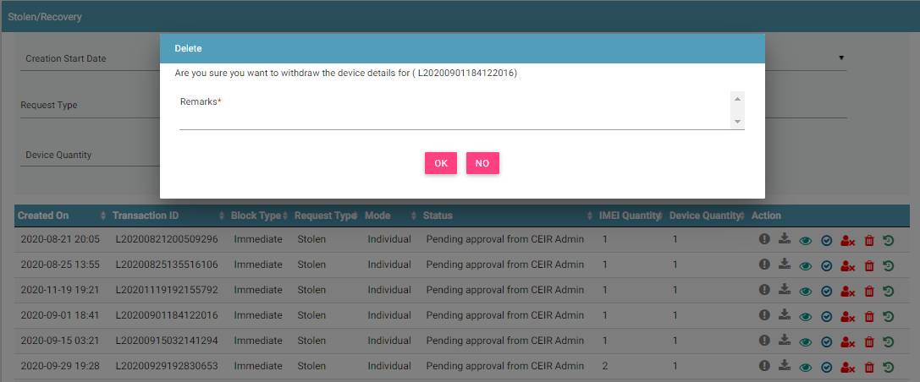
Request Withdrawn By CEIR Admin
CEIR Admin has the authority to withdraw any request. Remarks have to be updated for the same.

Slide 30
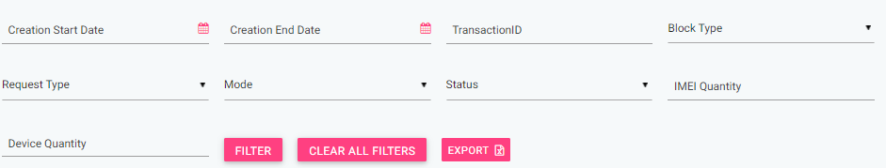
Filter Stolen/Recovery Request
Request can be filtered on the basis of
Date filters, Transaction ID, Block Type, Request Type, Mode, Status, IMEI quantity, Device quantity
User ( Lawful Agency/ CEIR Admin) can also use a combination of more than one filters to filter the request.
Users can view old request using the date filter.
Clear All Filters can be used to clear filters and refresh the data table.
Export button will export the data based on the filters applied.

Slide 31
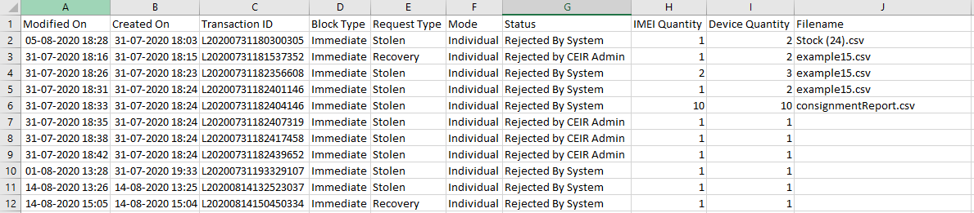
Export Stolen Recovery
Requests can be exported in a .csv file using the export button.
User can export all request assigned to the respective user.
User can export filtered request.

Slide 32
Sorting of data
By default, the data displayed is sorted in descending order on last modified date.
Data can be sorted based on other fields by clicking the arrow buttons on the column headers. On first click, data will be sorted in ascending order. On second click, it will be sorted in descending order.

Slide 33
Policy
Policy for grace and post grace period will be same for reporting stolen / recovery devices
Only device marked as stolen can be marked as recovered on the system
More details on same would be discussed in the “Policy Management” Training session

Slide 34
Whats Next
Once the local stolen list is created in the system, the same is used to generate the grey list/file which is downloaded by operator
The grey list as per the monitoring period as mentioned by the lawful agency.
Post expiry of monitoring period, the number will be moved to black list

Slide 35
Scenario
Scenario | Result
Lawful agency mark device as recovered which is not marked as stolen | Reject the Request
Lawful agency mark device as stolen but TAC check at GSMA has failed. | Policy Decision. It is recommended that this should not be allowed to ensure correct data in system
Lawful agency mark device as stolen but already marked stolen before | Reject the request
Lawful agency mark device as stolen but IMEI static validation fails (length, charset, Luhn Algorithm) | Policy Decision. It is recommended that this should not be allowed to ensure correct data in system

Slide 36
Queries

Slide 37
Thank You

